Slide 1
Practical Messaging
A 101 guide to messaging
Ian Cooper
Twitter: ICooper

Slide 2
Who are you?
Software Developer for over 20 years
Worked mainly for ISVs
Reuters, SunGard, Misys, Huddle
Worked for a couple of MIS departments
DTI, Beazley
Microsoft MVP for C#
Interested in OO design
Interested in Agile methodologies and practices
No smart guys
Just the guys in this room

Slide 3
Day Two Agenda
Fundamental Messaging Patterns
Competing Consumers
Pipes and Filters
Routers
Transformation
Management
Reliability
Durability and Persistence
Compensation
Guaranteed Delivery
Correctness
Reference Data
Versioning
Logs vs. Queues
CAP Theorem
Frameworks
Middleware
Putting It All Together
Your very own Tea Server

Slide 4
Day Two

Slide 5
2.4 SCALING OUT

Slide 6
Competing Consumers
We cannot process the messages fast enough and we have high latency.
Eventual consistency at high latency looks like network partition
In addition a single consumer is bad – if it fails that failure cascades to callers.
Notes:
Context and Problem
We may decide to move to using a task queue to offload work from an endpoint – to smooth our peaks and troughs or avoid chain failure where resources on the endpoint queue waiting for other services or processes.
If we cannot process messages on the work queue fast enough we can run in to other difficulties
Eventual consistency at high latency looks like network partition
The workload on the queue may be uneven – particularly when the queue is used to throttle requests from the endpoint. Under normal load a single consumer may be enough, under peak load it may not.
A single consumer is bad; active-active may be better than active-passive.

Slide 7
DIAGRAM: Have a service A that calls B that calls a Db using middleware for decoupled invocation. Next picture queue backs up because we can’t read messages fast enough. Front end experiences a partition as latency increases. Now show a queue between A and B with multiple consumers that can process messages fast enough to keep up.

Slide 8
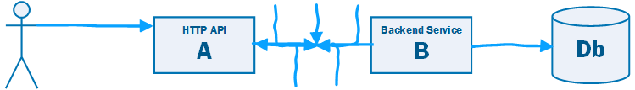

Slide 9
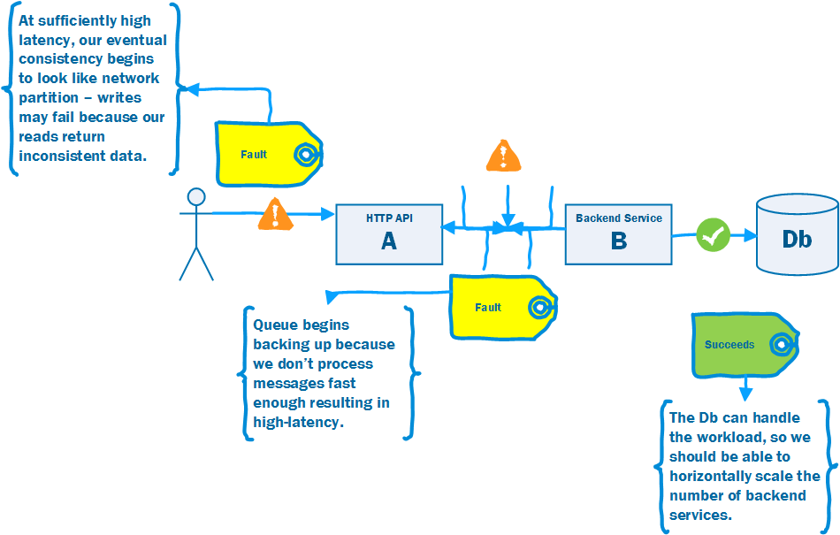

Slide 10
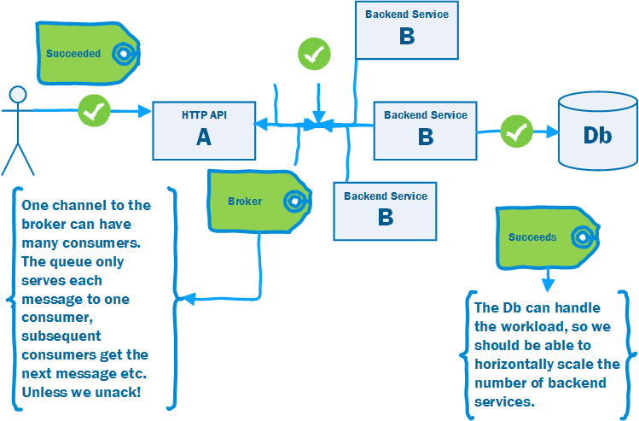

Slide 11
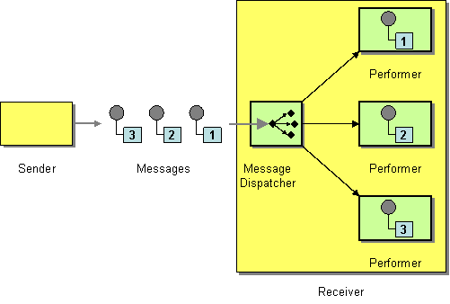
Competing Consumers
http://www.enterpriseintegrationpatterns.com/patterns/messaging/MessageDispatcher.html
Notes:
Increase the number of consumers reading messages from the queue. The message queue must hand a message to only one consumer. It must allow waiting consumers to read messages further down the queue if the message at the top is locked.
Highly Scalable, particularly with elastic compute – just add consumer nodes.

Slide 12
Ordering is an issue as consumers run at different rates. Two main solutions:
1. Sorting into order, using the queue, not processing out of order. This can be less performant than having no competing consumers.
2. Ensure messages can run when out-of-order i.e. idempotency

Slide 13
2.5 Pipes and Filters Architectures

Slide 14

Pipes and Filters
http://www.enterpriseintegrationpatterns.com/patterns/messaging/PipesAndFilters.html
Notes:
Pipes and Filters 5m
May need to do 'work' when transmitting a message - we might need to encrypt/decrypt a message, we might need to enrich the content of the message from collaborators before delivery, we might need to transform the message between source and destination if we do not control and cannot manage both, we might need to route messages.
Pipes and filters is a Unix pattern for dividing work into small, daily testable pieces that can be combined together. We can treat a channel as the pipe, and processes that read from and forward to as filters, to adjust a message. Often we want to abstract the channel, so we can choose between MOM or an in-memory queue for runtime efficiency.
The structure of pipes and filters is straightforward. Each filter receives a message on an inbound channel and publishes it on an outbound channel. Because each filter uses the same approach they can be composed into a chain. This allows simple, easily testable filters to be composed into arbitrarily complex applications. Composition allows us to re-use filters in new contexts, without changing them (in OO this is the Open-Closed principle).
In the original Pipes and Filters pattern the interface of a filter has one input and one outputs. Messaging relaxes this somewhat to allow
A processing pipeline lets us work in parallel, because a filter can take more work off the queue to process when done, instead of blocking whilst the rest of the pipeline completes. This is known as a processing pipeline because messages flow through the filters like liquid through a pipe. A processing pipeline helps to increase throughput.
A processing pipeline's throughput is limited by the slowest point in the chain. We could use multi-threading within that filter, but the alternative is to use competing consumers to parallelize the work of a stage. This allows one of many consumers to complete the work of that stage and is simpler to program and debug than using multi-threading.
In many enterprise integration scenarios, a single event triggers a sequence of processing steps, each performing a specific function. For example, let's assume a new order arrives in our enterprise in the form of a message. One requirement may be that the message is encrypted to prevent eavesdroppers from spying on a customer's order. A second requirement is that the messages contain authentication information in the form of a digital certificate to ensure that orders are placed only by trusted customers. In addition, duplicate messages could be sent from external parties (remember all the warnings on the popular shopping sites to click the 'Order Now' button only once?). To avoid duplicate shipments and unhappy customers, we need to eliminate duplicate messages before subsequent order processing steps are initiated. To meet these requirements, we need to transform a stream of possibly duplicated, encrypted messages containing extra authentication data into a stream of unique, simple plain-text order messages without the extraneous data fields.
How can we perform complex processing on a message while maintaining independence and flexibility?
Use the Pipes and Filters architectural style to divide a larger processing task into a sequence of smaller, independent processing steps (Filters) that are connected by channels (Pipes).
Each filter exposes a very simple interface: it receives messages on the inbound pipe, processes the message, and publishes the results to the outbound pipe. The pipe connects one filter to the next, sending output messages from one filter to the next. Because all component use the same external interface they can be composed into different solutions by connecting the components to different pipes. We can add new filters, omit existing ones or rearrange them into a new sequence -- all without having to change the filters themselves. The connection between filter and pipe is sometimes called port. In the basic form, each filter component has one input port and one output port.

Slide 15
2.6 Routers

Slide 16
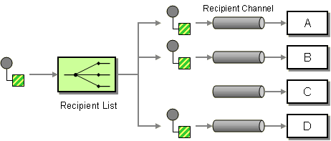
Recipient List
http://www.enterpriseintegrationpatterns.com/patterns/messaging/RecipientList.html
Notes:
A Content-Based Router allows us to route a message to the correct system based on message content. This process is transparent to the original sender in the sense that the originator simply sends the message to a channel, where the router picks it up and takes care of everything.
In some cases, though, we may want to specify one or more recipients for the message. A common analogy are the recipient lists implemented in most e-mail systems. For each e-mail message, the sender can specify a list of recipients. The mail system then ensures transport of the message content to each recipient. An example from the domain of enterprise integration would be a situation where a function can be performed by one or more providers. For example, we may have a contract with multiple credit agencies to assess the credit worthiness of our customers. When a small order comes in we may simply route the credit request message to one credit agency. If a customer places a large order, we may want to route the credit request message to multiple agencies and compare the results before making a decision. In this case, the list of recipients depends on the dollar value of the order.
In another situation, we may want to route an order message to a select list of suppliers to obtain a quote for the requested item. Rather than sending the request to all vendors, we may want to control which vendors receive the request, possibly based on user preferences
How do we route a message to a list of dynamically specified recipients?
Define a channel for each recipient. Then use a Recipient List to inspect an incoming message, determine the list of desired recipients, and forward the message to all channels associated with the recipients in the list.
The logic embedded in a Recipient List can be pictured as two separate parts even though the implementation is often coupled together. The first part computes a list of recipients. The second part simply traverses the list and sends a copy of the received message to each recipient. Just like a Content-Based Router, the Recipient List usually does not modify the message contents.
Recipient List: Define a channel for each recipient. Then use a Recipient List to inspect an incoming message, determine the list of desired recipients, and forward the message to all channels associated with the recipients in the list.
The logic embedded in a Recipient List can be pictured as two separate parts even though the implementation is often coupled together. The first part computes a list of recipients. The second part simply traverses the list and sends a copy of the received message to each recipient. Just like a Content-Based Router (230), the Recipient List usually does not modify the message contents.
The list of recipients can be derived from a number of sources. The creation of the list can be external to the Recipient List so that the message originator or another component attaches the list to the incoming message.
Dynamic Recipient List: To implement this functionality, recipients can send their subscription preferences to the Recipient List via a special control channel. The Recipient List stores the preferences in a rules base and uses it to compile the recipient list for each message. This approach gives the subscribers control over the message filtering but leverages the efficiency of the Recipient List to distribute the messages. This solution combines the properties of a Dynamic Router with a Recipient List to create a dynamic Recipient List (see figure).
A dynamic Recipient List can be used to implement a Publish-Subscribe Channel if a messaging system provides only Point-to-Point Channels but no Publish-Subscribe Channels. The Recipient List would keep a list of all Point-to-Point Channels that are subscribed to the topic. Each topic can be represented by one specific Recipient List instance. This solution can also be useful if we need to apply special criteria to allow recipients to subscribe to a specific data source. While most Publish-Subscribe Channels allow any component to subscribe to the channel, the Recipient List could easily implement logic to control access to the source data by limiting who gets to subscribe to the list. Of course, this assumes that the messaging system prevents the recipients from directly accessing the input channel into the Recipient List.

Slide 17
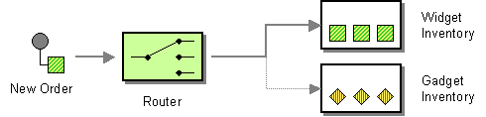
Content Based Router
http://www.enterpriseintegrationpatterns.com/patterns/messaging/ContentBasedRouter.html
Notes:
Assume that we are building an order processing system. When an incoming order is received, we first validate the order and then verify that the ordered item is available in the warehouse. This function is performed by the inventory system. This sequence of processing steps is a perfect candidate for the Pipes and Filters style. We create two filters, one for the validation step and one for the inventory system, and route the incoming messages through both filters. However, in many enterprise integration scenarios more than one inventory system exists with each system being able to handle only specific items.
How do we handle a situation where the implementation of a single logical function (e.g., inventory check) is spread across multiple physical systems?
Use a Content-Based Router to route each message to the correct recipient based on message content.
The Content-Based Router examines the message content and routes the message onto a different channel based on data contained in the message. The routing can be based on a number of criteria such as existence of fields, specific field values etc. When implementing a Content-Based Router, special caution should be taken to make the routing function easy to maintain as the router can become a point of frequent maintenance. In more sophisticated integration scenarios, the Content-Based Router can take on the form of a configurable rules engine that computes the destination channel based on a set of configurable rules.
Content Based Router: The Content-Based Router examines the message content and routes the message onto a different channel based on data contained in the message. The routing can be based on a number of criteria, such as existence of fields, specific field values, and so on. When implementing a Content-Based Router, special caution should be taken to make the routing function easy to maintain, as the router can become a point of frequent maintenance. In more sophisticated integration scenarios, the Content-Based Router can take on the form of a configurable rules engine that computes the destination channel based on a set of configurable rules.

Slide 18
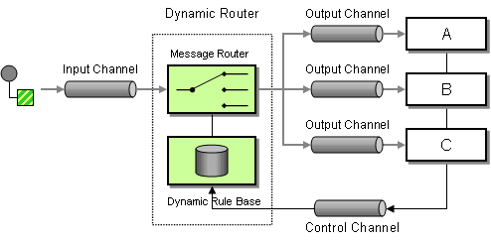
Dynamic Router
http://www.enterpriseintegrationpatterns.com/patterns/messaging/DynamicRouter.html
Notes:
You are using a Message Router to route messages between multiple destinations.
How can you avoid the dependency of the router on all possible destinations while maintaining its efficiency?
Use a Dynamic Router, a Router that can self-configure based on special configuration messages from participating destinations.
Besides the usual input and output channels the Dynamic Router uses an additional control channel. During system start-up, each potential recipient sends a special message to the Dynamic Router on this control channel, announcing its presence and listing the conditions under which it can handle a message. The Dynamic Router stores the 'preferences' for each participant in a rule base. When a message arrives, the Dynamic Router evaluates all rules and routes the message to the recipient whose rules are fulfilled. This allows for efficient, predictive routing without the maintenance dependency of the Dynamic Router on each potential recipient.
Dynamic Router: Besides the usual input and output channels, the Dynamic Router uses an additional control channel. During system startup, each potential recipient sends a special message to the Dynamic Router on this control channel, announcing its presence and listing the conditions under which it can handle a message. The Dynamic Router stores the preferences for each participant in a rule base. When a message arrives, the Dynamic Router evaluates all rules and routes the message to the recipient whose rules are fulfilled. This allows for efficient, predictive routing without the maintenance dependency of the Dynamic Router on each potential recipient. In the most basic scenario, each participant announces its existence and routing preferences to the Dynamic Router at startup time. This requires each participant to be aware of the control queue used by the Dynamic Router. It also requires the Dynamic Router to store the rules in a persistent way. Otherwise, if the Dynamic Router fails and has to restart, it would not be able to recover the routing rules. Alternatively, the Dynamic Router could send a broadcast message to all possible participants to trigger them to reply with the control message. This configuration is more robust but requires the use of an additional
Publish-Subscribe Channel.
A common use of the Dynamic Router is dynamic service discovery in service-oriented architectures. If a client application wants to access a service, it sends a message containing the name of the service to the Dynamic Router. The Dynamic Router maintains a service directory, a list of all services with their name and the channel they listen on. The router builds this directory based on control messages from each service provider. When a service request arrives, the Dynamic Router uses the service directory to look up the service by name, then routes the message to the correct channel. This setup allows the client application to send command messages to a single channel without having to worry about the nature or location of the specified service provider, even if the provider changes.

Slide 19
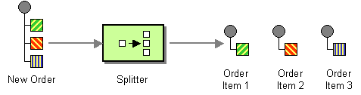
Splitter
http://www.enterpriseintegrationpatterns.com/patterns/messaging/Sequencer.html
Notes:
Many messages passing through an integration solution consist of multiple elements. For example, an order placed by a customer consists of more than just a single line item. As outlined in the description of the Content-Based Router, each line item may need to be handled by a different inventory system. Thus, we need to find an approach to process a complete order, but treat each order item contained in the order individually.
How can we process a message if it contains multiple elements, each of which may have to be processed in a different way?
Use a Splitter to break out the composite message into a series of individual messages, each containing data related to one item.
use a Splitter that consumes one message containing a list of repeating elements, each of which can be processed individually. The Splitter publishes a one message for each single element (or a subset of elements) from the original message.

Slide 20
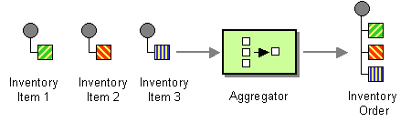
Aggregator
http://www.enterpriseintegrationpatterns.com/patterns/messaging/Aggregator.html
Notes:
A Splitter is useful to break out a single message into a sequence of sub-messages that can be processed individually. Likewise, a Recipient List or a Publish-Subscribe Channel is useful to forward a request message to multiple recipients in parallel in order to get multiple responses to choose from. In most of these scenarios, the further processing depends on successful processing of the sub-messages. For example, we want to select the best bid from a number of vendor responses or we want to bill the client for an order after all items have been pulled from the warehouse.
How do we combine the results of individual, but related messages so that they can be processed as a whole?
Use a stateful filter, an Aggregator, to collect and store individual messages until a complete set of related messages has been received. Then, the Aggregator publishes a single message distilled from the individual messages.
The Aggregator is a special Filter that receives a stream of messages and identifies messages that are correlated. Once a complete set of messages has been received (more on how to decide when a set is 'complete' below), the Aggregator collects information from each correlated message and publishes a single, aggregated message to the output channel for further processing.

Slide 21
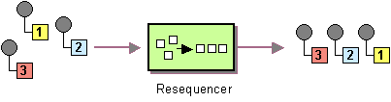
Resequencer
http://www.enterpriseintegrationpatterns.com/patterns/messaging/Resequencer.html
Notes:
A Message Router can route messages from one channel to different channels based on message content or other criteria. Because individual messages may follow different routes, some messages are likely to pass through the processing steps sooner than others, resulting in the messages getting out of order. However, some subsequent processing steps do require in-sequence processing of messages, for example to maintain referential integrity.
How can we get a stream of related but out-of-sequence messages back into the correct order?
Use a stateful filter, a Resequencer, to collect and re-order messages so that they can be published to the output channel in a specified order.
The Resequencer can receive a stream of messages that may not arrive in order. The Resequencer contains in internal buffer to store out-of-sequence messages until a complete sequence is obtained. The in-sequence messages are then published to the output channel. It is important that the output channel is order-preserving so messages are guaranteed to arrive in order at the next component. Like most other routers, a Resequencer usually does not modify the message contents.

Slide 22
2.8 Transformation

Slide 23
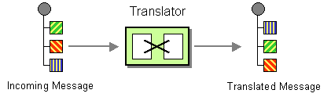
Message Translator
http://www.enterpriseintegrationpatterns.com/patterns/messaging/MessageTranslator.html
Notes:
The previous patterns describe how to construct messages and how to route them to the correct destination. In many cases, enterprise integration solutions route messages between existing applications such as legacy systems, packaged applications, homegrown custom applications, or applications operated by external partners. Each of these applications is usually built around a proprietary data model. Each application may have a slightly different notion of the Customer entity , the attributes that define a Customer and which other entities a Customer is related to. For example, the accounting system may be more interested in the customer's tax payer ID numbers while the customer-relationship management (CRM) system stores phone numbers and addresses. The application’s underlying data model usually drives the design of the physical database schema, an interface file format or a programming interface (API) -- those entities that an integration solution has to interface with. As a result, the applications expect to receive messages that mimic the application's internal data format.
In addition to the proprietary data models and data formats incorporated in the various applications, integration solutions often times interact with standardized data formats that seek to be independent from specific applications. There are a number of consortia and standards bodies that define these protocols, such as RosettaNet, ebXML, OAGIS and many other, industry specific consortia. In many cases, the integration solution needs to be able to communicate with external parties using the ‘official’ data formats while the internal systems are based on proprietary formats.
How can systems using different data formats communicate with each other using messaging?
Use a special filter, a Message Translator, between other filters or applications to translate one data format into another.
The Message Translator is the messaging equivalent of the Adapter pattern described in [GoF]. An adapter converts the interface of a component into a another interface so it can be used in a different context.

Slide 24
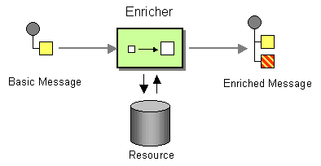
Content Enricher
http://www.enterpriseintegrationpatterns.com/patterns/messaging/DataEnricher.html
Notes:
When sending messages from one system to another it is common for the target system to require more information than the source system can provide. For example, incoming Address messages may just contain the ZIP code because the designers felt that storing a redundant state code would be superfluous. Likely, another system is going to want to specify both a state code and a ZIP code field. Yet another system may not actually use state codes, but spell the state name out because it uses free-form addresses in order to support international addresses. Likewise, one system may provide us with a customer ID, but the receiving system actually requires the customer name and address. An order message sent by the order management system may just contain an order number, but we need to find the customer ID associated with that order, so we can pass it to the customer management system. The scenarios are plentiful.
How do we communicate with another system if the message originator does not have all the required data items available?
Use a specialized transformer, a Content Enricher, to access an external data source in order to augment a message with missing information.
The Content Enricher uses information inside the incoming message (e.g. key fields) to retrieve data from an external source. After the Content Enricher retrieves the required data from the resource, it appends the data to the message. The original information from the incoming message may be carried over into the resulting message or may no longer be needed, depending on the specific needs of the receiving application.

Slide 25
2.9 Management

Slide 26
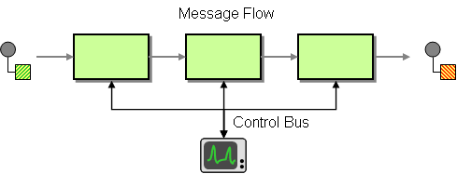
Control Bus
http://www.enterpriseintegrationpatterns.com/patterns/messaging/ControlBus.html
Notes:
How can we effectively administer a messaging system that is distributed across multiple platforms and a wide geographic area?
Use a Control Bus to manage an enterprise integration system. The Control Bus uses the same messaging mechanism used by the application data, but uses separate channels to transmit data that is relevant to the management of components involved in the message flow.
Each component in the system is now connected to two messaging subsystems:

Slide 27
3. reliability

Slide 28
3.1 Compensation

Slide 29
Compensation: Write Off
A
B
2: Handle Event
1: Raise Event
C
2: Application Exception
29
Notes:
Write-off
This is the simplest strategy: do nothing, or discard what you’ve done (see Figure 1a). This might seem like a poor plan, but in the reality of business, it might be acceptable. If the loss is small, building
an error-correction solution might be more expensive. Furthermore, it might slow down the flow of messages, which reduces system throughput.

Slide 30
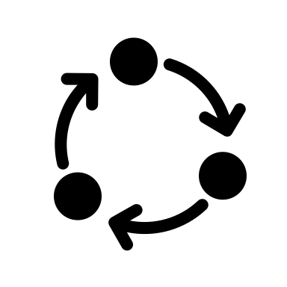

Compensation: Retry
A
B
2: Handle Event
1: Raise Event
3: Retry
4: Circuit Breaker
C
2: Application Exception
30
Notes:
Retry
When one operation out of a group of operations (or “transactions”) fails, you have essentially two choices: undo the ones that completed successfully or retry the one that failed. Retry is a plausible
option if there’s a realistic chance that the retry will succeed (see Figure 1b). For example, if an external system is temporarily unavailable or an item is out of stock, a retry might be worthwhile.
However, if a business rule was violated, it’s unlikely a retry will succeed.

Slide 31
Compensation: Compensating Event
A
B
2: Handle Event
5: Compensate
1: Raise Event
5: Compensate
C
2: Application Exception
4: Raise Compensating Event
31
Notes:
Compensating action
The obvious alternative to retrying failed operations is to undo already completed operations to return the system to a consistent state (see Figure 1c). Such compensating actions work best with monetary systems, where we can credit money already debited. But real life uses many other compensating actions. For example, we might call and ask a customer to ignore a letter that has been sent or to return a package that was sent in error.

Slide 32
Compensation: Routing Slip
A
B
2: Handle Event
5: Compensate
1: Raise Event
5: Compensate
C
2: Application Exception
4: Raise Compensating Event
32
Notes:
Routing Slip
An alternative to listening for events to trigger compensating actions is to attach the sequence of handlers to the message itself, describing both the happy path, and the failure path. As each node processes the message, it looks at the sequence to determine where to route either the next step in the sequence, or the compensation flow.

Slide 33
Compensation: Process Manager (Saga)
A
B
6: Compensate
5: Compensate
2: Handle Event
4: Raise Compensating Event
1: Raise Event
C
Process Manager
3: Application Exception
33
Notes:
Transaction coordinator
The strategies discussed thus far differ from a traditional two-phase commit that relies on separate prepare and execute steps for each participant. In the Starbucks example, a two-phase commit would equate to having the customer wait at the cashier’s counter with money and the receipt until the drink is ready. Then, the money, receipt, and drink would change hands in one swoop. Neither the cashier nor the customer could leave until the transaction was complete.
Using such a two-phase-commit approach would certainly kill a coffee shop’s business because it would dramatically decrease the number of customers the shop could serve in a certain time interval. Although a two-phase commit can make life a lot simpler, it can also hurt the free flow of messages (and therefore scalability) because it requires the allocation of a stateful transaction resource across the flow of multiple, asynchronous actions. Starbucks follows an optimistic approach to optimize throughput in the “happy day” scenario, even though this results in a small loss when errors occur.
When amounts and stakes are larger, a pessimistic two-phase-commit approach is more appropriate (see Figure 1d). For example, when you purchase a home, an escrow company essentially acts as a transaction coordinator, offering a two-phase-commit service. The escrow company ensures that all required resources from all parties, such as funds, documents, and permits, are available before committing the transaction—that is, the purchase of the property. Once the transaction closes, all resources are consistently committed across all parties.

Slide 34
3.2 guaranteed delivery
At Least Once

Slide 35
Client
Master
Mirror
A
B
myQueue
2
myQueue
1
3
2
C
Client
RMQ Cluster
3
Mirror
myQueue
35
Notes:
The problem with a distributed transaction
1: I try to write to the queue
2: The queue creates a transaction and writes to all the other queues in the cluster. Note that this might be in a different AZ
3: The queue then responds when the message has been written to the queue
What happens on failure to write to a node? MoM defined. RMQ for example will not guarantee, better to use publisher confirms that send you an ack when the message is written to the queue (persistent) or when it is consumed (non-persistent) and then resend when failed

Slide 36
Message
A
A
Message
Ack
Store Message
Store Message
Resend message if no acknowledgement sent
Notes:
How can you ensure that messages are received successfully?
For each message retrieved by a receiver an acknowledgement is sent back to the message sender. If this acknowledgement is not received after a certain time frame, the message is resent.
We may not know if the acknowledgement itself failed, but the original send succeeded.

Slide 37
3.3 At least once, Exactly once

Slide 38
Message
A
A
Ack
Message
Ack
Notes:
How can you ensure that messages are received successfully?
For each message retrieved by a receiver an acknowledgement is sent back to the message sender. If this acknowledgement is not received after a certain time frame, the message is resent.
We may not know if the acknowledgement itself failed, but the original send succeeded.

Slide 39
Message
A
A
Ack
Message
Store Message
Check for Message having been seen
Notes:
So we need to have an idempotent receiver that can reject messages already seen, or is not affected by re-application.
We could also ensure that logically we could re-apply the message

Slide 40
Message
A
A
Ack
Message
Store Message
Check for Message having been seen
Notes:
We can combine guaranteed delivery and at-least once to ensure that messages will be delivered once.

Slide 41
3.4 Correctness

Slide 42
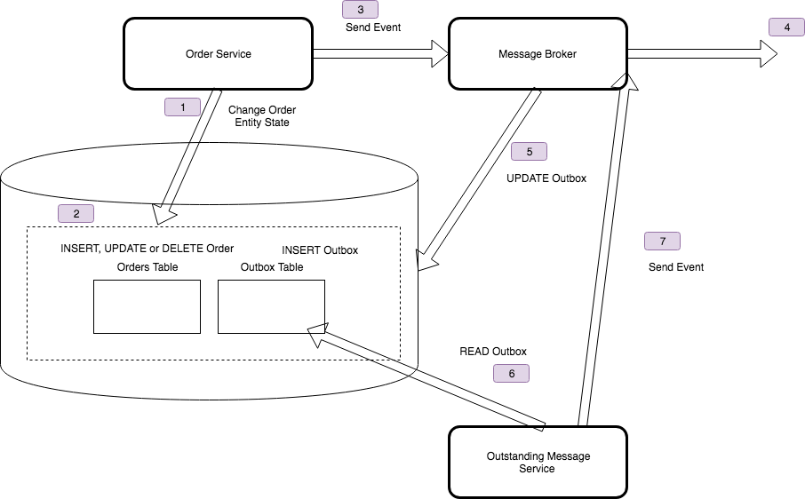
Outbox Pattern

Slide 43
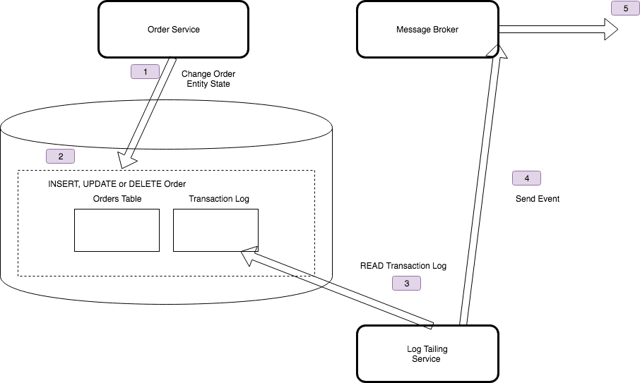
Log Tailing

Slide 44
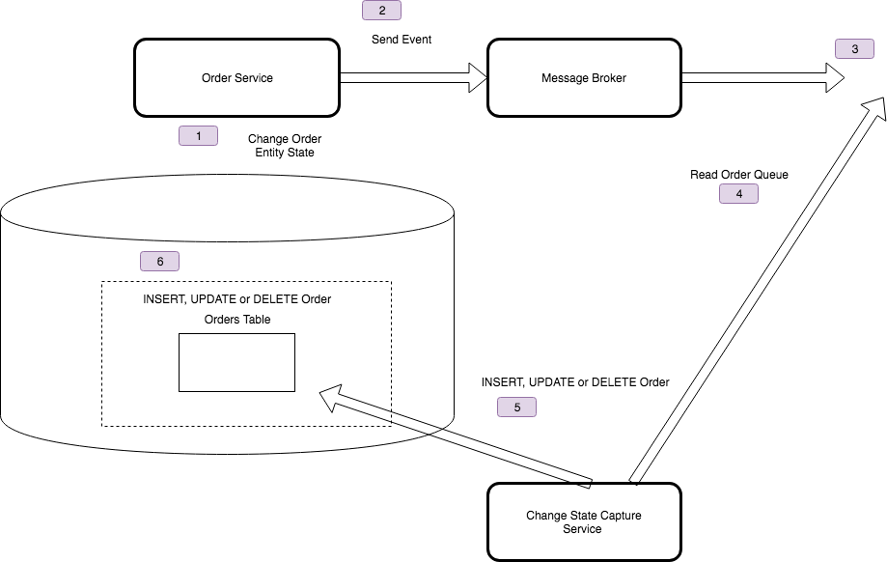
State Change Capture

Slide 45
3.5 Pipelines, Conversations & Reference Data
Event Carried State Transfer

Slide 46


Event Driven Architecture
Direct
Bookings
Credit Card
Payments
Accounts
Housekeeping
Channel Manager
API
API
API
API
API
?
Db
Db
Db
Db
Db
Broker
Notes:
We raise a booking event and it travels down the bus before being opened by the credit card payments service
The credit card payment service reads the message, that a booking has been made, and now needs to process the payment. But how?
Does it call the Direct Bookings API to get hold of the data?
- If we do this we are back where we started, and the

Slide 47

I have a local cache of the other services data, that I can use to service requests
Credit Card
Payments
Push
Not
Pull
API
Accounts
Reference
Cache
Credit Card
Payments
API
Payments
Db
I receive a Document Message that contains the data required to process event
Payments
Db

Slide 48
Pipes and Filters
Direct Bookings
Accounts
Credit Card
Payments
API
API
API
Credit Card Payments can use the enriched information to process
We send the booking message to Account to enrich it.
Bookings Db
Accounts Db
Credit Card Db
Broker
Notes:
Pipes and Filters
One way to add the information we need to the document message is to route if via systems that can enrich it with data.
We might have two customers: guest accounts, that include the payment details in their booking, and and subscriber accounts that have already registered their payment details.
We can turn this into one ’booking made’ request by passing it through a pipeline, so that when a subscriber account booking is made, which has no payment data, we enrich the message with the missing data before passing it downstream to the credit card service. This helps us keep services from needing to make a request to the service that originates the data, by including the missing values in the message.

Slide 49
API Gateway
3:Saga sends enriched booking message
Direct Bookings
Accounts
Credit Card
Payments
API
API
API
2:Saga gets account details
Conversations
1:Saga makes a booking
Bookings Db
Accounts Db
Credit Card Db
Broker

Slide 50
Reference Data
GET \booking\12345 HTTP 1.1
Cache-Control: max-age=30
If-Modified-Since: Fri 20 April 2019 09:00 GMT
Pat Helland
Direct
Bookings
API
Outside Data
Services are Autonomous
Immutable, stale, versioned
Boundaries are Explicit
Single Writer
Db
Booking.Created.Event
Message-Id: aa95b387-a17f-4907-a1d8-e597c322bfc6
Correlation-Id: d060cb3f-ec71-4257-b5c8-819d1a9ca6cb
{ items : [Booking {…}]}
Inside Data
Share Schema not Type

Slide 51
Reference Data is Protocol Agnostic
Accounts
Credit Card
Payments
API
API
FTP
Accounts Db
ETL
Accounts
Reference Cache
Credit Card Db
ATOM
ECST

Slide 52
Event Carried
State Transfer
POST /payments/card/booking/12345/98765
{ [payment: {
type:credit card
…
}}
Martin Fowler
Credit Card Payments
API
Read Customer info
Notify Downstream Consumers
Worker
Write Payment
Details
Accounts Ref Db
CC Payments Db

Slide 53
3.6 Versioning

Slide 54
Be strict when sending and tolerant when receiving. Implementations must follow specifications precisely when sending to the network, and tolerate faulty input from the network.
Robustness Principal or Postel’s Law – Jon Postel RFC 1958

Slide 55
Tolerant Reader
Account No:
Withdrawn:
Currency:
Date:
Long:
Lat:
Format: V2
Account No:
Withdrawn:
Currency:
Date:
Format: V1
Ignore New Fields
Notes:
A general rule when versioning events is that adding things does not cause a versioning conflict. Adding a new version of an event is therefore not a problem, as long as we don’t break the definition of a new version event; it must be convertible from an old version of the same event. Following these rules, when old versions are read from the store, they can first be converted, or upcasted, to the latest version before handled. This means that an event handler only needs to know how to deal with the latest version, an important benefit if many new versions have been created. To be able to convert an old version of an event when a property has been added to the new version, we use the same principle as when we add a new not nullable column to a database; we use a default value.
With Additive Changes we can process new messages on old consumers
New Consumers must default missing values from older messages
Might use Enricher.

Slide 56
Tolerant Reader
Account No:
Withdrawn:
Currency:
Date:
Long:
Lat:
Format: V2
Account No:
Withdrawn:
Currency:
Date:
Format: V1
Long: 0
Lat: 0
Default Missing Fields

Slide 57
Breaking Change
Account No:
Withdrawn:
Currency:
Date:
Format: V1
Account No:
New Balance:
Date:
Format: V2
Account.Withdrawal.Event
Account.NewBalance.Event
New Message
Notes:
With Breaking Changes we should create a new message type.
Source systems may need to send original and new, or we have to source the missing information in a Message Translator in the pipeline

Slide 58
Consumer Driven Contracts
Contract
Producer
Consumer
Adopt Required
Parts
Consumer Driven Contracts
Provider Contract
Consumer Contract
Consume According To
Validate
Set Expectations
Execute
Notes:
A Provider Contract is a description of a service offered by a provider
A Consumer Contract is a description of the extent to which a consumer utilises a Provider Contract
A Consumer Driven Contract is a description of how a provider satisfies an aggregate of Consumer Contracts

Slide 59
3.7 Message LOGs and Shared Queues

Slide 60
Shared Queue
Accountss
Credit Card
Payments
API
API
The message is deleted from the queue once actioned
Credit Card Db
Accounts Db
Accounts
Reference Cache
Outbox
Inbox
Replay must use the Outbox
De-duplication requires the Inbox
Broker
Notes:
Shared Message Queue or Shared Message Log
All distributed messaging systems store their data, replicated across nodes in a cluster, using some form of Db
In a Shared Message Queue, that storage has queue semantics, we can lock an item of the front of the queue, so as to allow other readers to skip past it, retrieve an item from the queue, and either unlock or delete the item at the end. We usually unlock for a failure to process, and delete when done. So our storage is mutable, once we have processed an item, we have changed the queue.
In a message log, the storage has append-only log semantics. We maintain an index to the next item for a consumer to read, in order, and we can manage those indexes in the distributed system to allow multiple consumers to traverse the same queue together, but we never alter the queue. So after we finish processing a message we just increment the index.
We use more storage for the log, because we are not deleting messages, but we gain the ability to reset our index and replay the messages.
With a shared queue, replay depends on an outbox or inbox
We started buy using a shared message queue and listening for downstream events
We solved ordering by using a sequential version number and resequencing when 'out-of-order'
Ordering creates a problem for consumers
We could add a sequence number to enforce ordering
[Does not work with competing consumers
We can create partitions to allow competing consumers to work
All events need to be under one topic
We may have events for a lot of entities. How do we partition?
Has limitations. How do I replay, so that I can spin up a new service (big problem in QA envirionments)?
We had an 'Outbox' but still, we needed to write code to resend and ensure other consumers discarded duplicates (i.e. have we seen this message or this version of the data for this id)
We then moved to using a shared message log (in our case GES, but Kafka is probably the default choice for many)
Arguably this is Active Service over Event Carried State Transfer, because like an ATOM-feed we pull the 'current' state by reading an immutable, read-only feed to populate our cache

Slide 61
Message Log
Accounts
Credit Card
Payments
API
API
Replay just resets the queue index for next
Credit Card Db
Accounts Db
Accounts
Reference Cache
The message remains in the queue
Outbox
Inbox
Broker
Outbox only needed if required for correctness
Inbox only needed if log does not support once-only
Notes:
Shared Message Queue or Shared Message Log
All distributed messaging systems store their data, replicated across nodes in a cluster, using some form of Db
In a Shared Message Queue, that storage has queue semantics, we can lock an item of the front of the queue, so as to allow other readers to skip past it, retrieve an item from the queue, and either unlock or delete the item at the end. We usually unlock for a failure to process, and delete when done. So our storage is mutable, once we have processed an item, we have changed the queue.
In a message log, the storage has append-only log semantics. We maintain an index to the next item for a consumer to read, in order, and we can manage those indexes in the distributed system to allow multiple consumers to traverse the same queue together, but we never alter the queue. So after we finish processing a message we just increment the index.
We use more storage for the log, because we are not deleting messages, but we gain the ability to reset our index and replay the messages.
With a shared queue, replay depends on an outbox or inbox
We started buy using a shared message queue and listening for downstream events
We solved ordering by using a sequential version number and resequencing when 'out-of-order'
Ordering creates a problem for consumers
We could add a sequence number to enforce ordering
[Does not work with competing consumers
We can create partitions to allow competing consumers to work
All events need to be under one topic
We may have events for a lot of entities. How do we partition?
Has limitations. How do I replay, so that I can spin up a new service (big problem in QA envirionments)?
We had an 'Outbox' but still, we needed to write code to resend and ensure other consumers discarded duplicates (i.e. have we seen this message or this version of the data for this id)
We then moved to using a shared message log (in our case GES, but Kafka is probably the default choice for many)
Arguably this is Active Service over Event Carried State Transfer, because like an ATOM-feed we pull the 'current' state by reading an immutable, read-only feed to populate our cache

Slide 62
We care about Current State
We care about History
Analysis Services
Accountss
Credit Card
Payments
API
API
API
Stream
Data Lake
4: Ingest Analytical Data
Accounts Db
Accounts
Reference Cache
Credit Card Db
7: Ingest Analytical Data
1: Store Current State
3: Save Reference Data
2: Raise Event
5: Store Current State
6: Raise Event

Slide 63
Unpopular Opinion
Where we perform analysis in data lake, populated from a stream, we only care about current state in our transactional system.
A message log lets us replay the event history that gets to current state into a lake
The lake is where we analyze data from the perspective of transitions and build new projections
Under this model there is no requirement for event sourcing.

Slide 64
3.8 cap theorem

Slide 65
You can have at most two of these properties for any shared data system
Notes:
Created by Eric Brewer According to University of California, Berkeley computer scientist Eric Brewer, the theorem first appeared in autumn 1998.^{[6]} It was published as the CAP principle in 1999^{[7]} and presented as a conjecture by Brewer at the 2000 Symposium on Principles of Distributed Computing (PODC).^{[8]} In 2002, Seth Gilbert and Nancy Lynch of MIT published a formal proof of Brewer's conjecture, rendering it a theorem.
Consistency - A read is guaranteed to return the most recent write for a given client.
Availability - A non-failing node will return a reasonable response within a reasonable amount of time (no error or timeout).
Partition Tolerance - The system will continue to function when network partitions occur.

Slide 66
Forfeit Partitions
Notes:
Forfeit the ability to cope with a network partition. How is this possible? We don’t distribute i.e. an RDBMS running on a single server, or in a cluster with 2-Phase Commit for consistency.
Assumption is that we are co-located in a rack and network partitions are rare and can be retried successfully within a timeout; or the server is on fire and we don’t care

Slide 67
Forfeit Availability
Notes:
Make minority partitions unavailable.
Distributed databases tend to use this approach. Tend to work with majority consensus protocols.
Rabbit MQ is here as the Mnesia database works this way.

Slide 68
Forfeit Consistency
Notes:
Serve data, even if it is stale. May be eventual consistency.
Web Caches
Expiration and Leases, Conflict Resolution (Etag, Last Modified, If-None-Match, If-Modified-Since)

Slide 69
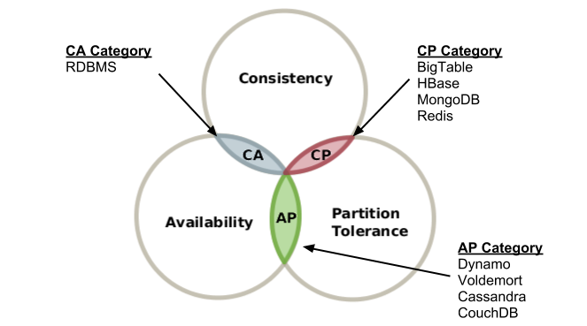

Slide 70
So it would seem that in order to maintain availability we would need to choose to trade either C or A in the event of a network partition
Daniel Abadi noted that the issue with this was that a CP system could choose to trade C for A in the event of a partition, but an AP system must always trade C for P, even when there is no partition.
To gain AP I have to accept latency (L) especially over a WAN as I have to replicate data asynchronously. If I accept L, I MUST sacrifice C at all times.
Notes:
Around 2010, Daniel Abadi of Yale noted some shortcomings of how the CAP theorem had been understood and applied:
The theorem seems to imply that you can choose any of these 3 configurations: CA, CP or AP. But A and C have an asymmetry here: if you choose to sacrifice A, you only have to do so when there’s a network partition. But systems that choose to sacrifice C (i.e. AP systems) must do so all the time.
For all practical purposes, CA and CP are identical, since the upshot of a partition on a CA (non-partition-tolerant) system is that Availability is lost. Which is the same as CP.
So for all intents and purposes, CAP focuses people on a single tradeoff: in the event of a partition, what does the system give up, C or A?
But even this is a false tradeoff, since it implies that we give up consistency to gain availability. This is not always the case.
Abadi notes that in the absence of a partition, a CAP-based system is free to make all the ACID guarantees along with high availability. The reason to give up consistency then was not to gain availability.
Abadi notes that the reason to give up consistency and/or availability is the missing incredient: Latency.
Keeping replicas consistent over a wide area network requires at least one message to be sent over the WAN in the critical path to perform the write (some think that 2PC is necessary, but my student Alex Thomson has some research showing that this is not the case — more on this in a future post). Unfortunately, a message over a WAN significantly increases the latency of a transaction (on the order of hundreds of milliseconds), a cost too large for many Web applications that businesses like Amazon and Yahoo need to implement. Consequently, in order to reduce latency, replication must be performed asynchronously. This reduces consistency (by definition).
A high availability requirement implies that the system must replicate data. As soon as a distributed system replicates data, a tradeoff between consistency and latency arises.

Slide 71
PACELC
A trade-off exists between latency and consistency, even in absence of partitions,
A high availability requirement implies that the system must replicate data. As soon as a distributed system replicates data, a tradeoff between consistency (C) and latency (L) arises.
Notes:
By contrast RPC trades L for C. As a blocking call we have to accept the latency of making one or more additional server hops in order to ensure that we are consistent with the other system.

Slide 72

Messaging trades latency for availability
Accounts
Credit Card
Payments
API
API
Accounts Db
Accounts
Reference Cache
Credit Card Db
Broker
Notes:
Messaging systems act as bulkheads

Slide 73
Messaging has Bulkheads
Accounts
Credit Card
Payments
API
API
Accounts Db
Accounts
Reference Cache
Credit Card Db
Broker
Notes:
Messaging systems trade consistency for availability

Slide 74
3.9 RabbitMQ and CAP Theorem

Slide 75
Client
Master
Mirror
A
B
myQueue
myQueue
C
Client
RMQ Cluster
Mirror
myQueue
Notes:
In an RMQ Cluster we have a leader node, and follower nodes. We want an odd number of nodes, 3 or 5 for examples, so that they can vote on who becomes the leader if the leader stops.
We replicate the exchange data out to all nodes in the cluster.
Clustering connects multiple machines together to form a single logical broker. Communication is via Erlang message-passing, so all nodes in the cluster must have the same Erlang cookie. The network links between machines in a cluster must be reliable, and all machines in the cluster must run the same versions of RabbitMQ and Erlang.
Virtual hosts, exchanges, users, and permissions are automatically mirrored across all nodes in a cluster.
Queues may be located on a single node, or mirrored across multiple nodes. A client connecting to any node in a cluster can see all queues in the cluster, even if they are not located on that node.
When a client connects to a queue, it always connects to the master, via the local node. The other queues only exist for the event of failure.
Each mirrored queue consists of one master and one or more mirrors. The master is hosted on one node commonly referred as the master node. Each queue has its own master node. All operations for a given queue are first applied on the queue's master node and then propagated to mirrors. This involves enqueueing publishes, delivering messages to consumers, tracking acknowledgements from consumers and so on.
Queue mirroring implies a cluster of nodes. It is therefore not recommended for use across a WAN (though of course, clients can still connect from as near and as far as needed).
Messages published to the queue are replicated to all mirrors. Consumers are connected to the master regardless of which node they connect to, with mirrors dropping messages that have been acknowledged at the master. Queue mirroring therefore enhances availability, but does not distribute load across nodes (all participating nodes each do all the work).
If the node that hosts queue master fails, the oldest mirror will be promoted to the new master as long as it synchronised. Unsynchronised mirrors can be promoted, too, depending on queue mirroring parameters.

Slide 76
Client
Master
Mirror
A
B
myQueue
myQueue
C
Client
RMQ Cluster
Master
myQueue
Notes:
In the event that there is a partition, then the partitioned node will decide that it is also a master. Thus this node is now out-of-sychronization i.e. has become inconsistent. As new messages are written to the exchange and published to attached nodes, they will not propogate to the other side of the partition.
By default we are AP, we have availability I can talk to both nodes in the event of a partition.
It is easy to see that we have sacrificed consistency in this instance.
If we publish to one node or the other, then we will not have those messages on both sides. If we have multiple clients of the queue i.e. competing consumers, we will not agree on what messages have already been processed i.e. we will get duplicates.
Now we could decide to ignore duplicates, but to ensure we did not want to risk losing messages we would have to ensure that we had consumers eating from both sides of the partition, which we might not be able to guarantee.

Slide 77
Client
Master
Mirror
A
B
myQueue
myQueue
C
Client
RMQ Cluster
Paused
myQueue
Notes:
In Pause Minority we switch RMQ from AP to CP.
In the presence of a partition we will pause the minority portion of the network. (We can use pause-if-all-down to deal with ties if we have even numbers of nodes). The paused node closes its sockets. So it is no longer available. When it rejoins the cluster, it will be unsynchronized as it will not have any messages published whilst it was paused. We usually wait until the existing nodes process outstanding, and then we will have caught up, but we can force synchronization.
If the node we are talking to partitions, our client will need to be aware that it will get socket closed exceptions.

Slide 78
Client
Master
Mirror
A
B
myQueue
myQueue
C
Client
RMQ Cluster
Paused
myQueue
Notes:
In Pause Minority we switch RMQ from AP to CP.
In the presence of a partition we will pause the minority portion of the network. (We can use pause-if-all-down to deal with ties if we have even numbers of nodes). The paused node closes its sockets. So it is no longer available.
If the node we are talking to partitions, our client will need to be aware that it will get socket closed exceptions.

Slide 79
Client
Master
Mirror
A
B
myQueue
myQueue
C
Client
RMQ Cluster
Unsychronized
myQueue
Notes:
When it rejoins the cluster, it will be unsynchronized as it will not have any messages published whilst it was paused. We usually wait until the existing nodes process outstanding, and then we will have caught up, but we can force synchronization.

Slide 80
Client
Master
Mirror
A
B
myQueue
myQueue
C
Client
RMQ Cluster
Mirror
myQueue
Notes:
We usually wait until the existing nodes process outstanding, and then we will have caught up, but we can force synchronization.

Slide 81
Client
Master
Mirror
A
B
myQueue
myQueue
C
Client
RMQ Cluster
Mirror
myQueue
Notes:
It is a little more complicated if the master is in the minority during a partition. Obviously we can no longer talk to the queue on master, which is what has been happening up to now.

Slide 82
Client
Paused
Master
A
B
myQueue
myQueue
C
Client
RMQ Cluster
Mirror
myQueue
Notes:
The nodes in the majority partition now elect a new master.
Now we have a situation where not only does a client talking to a partition that the socket will error, but now our consumer will no longer be connected to the master through its node. The new master will consider all mirrors to have been disconnected, even ones that were originally connected to that node. It will resend all unacked messages. A client might not be aware when the mirror it is attached to becomes the master, and therefore not understand that it needs to reconnect. Clients should therefore listen for consumer cancellation notifications and assume they have to reconnect and may receive duplicates.
The longest running mirror is promoted to master, the assumption being that it is most likely to be fully synchronised with the master. If there is no mirror that is synchronised with the master, messages that only existed on master will be lost.
The mirror considers all previous consumers to have been abruptly disconnected. It requeues all messages that have been delivered to clients but are pending acknowledgement. This can include messages for which a client has issued acknowledgements, say, if an acknowledgement was either lost on the wire before reaching the node hosting queue master, or it was lost when broadcast from the master to the mirrors. In either case, the new master has no choice but to requeue all messages that it has not seen acknowledgements for.
Consumers that have requested to be notified when a queue fails over will be notified of cancellation.
As a result of the requeuing, clients that re-consume from the queue must be aware that they are likely to subsequently receive messages that they have already received.
As the chosen mirror becomes the master, no messages that are published to the mirrored queue during this time will be lost (barring subsequent failures on the promoted node). Messages published to a node that hosts queue mirror are routed to the queue master and then replicated to all mirrors. Should the master fail, the messages continue to be sent to the mirrors and will be added to the queue once the promotion of a mirror to the master completes.
Messages published by clients using publisher confirms will still be confirmed even if the master (or any mirrors) fail between the message being published and a confirmation received by the publisher. From the point of view of the publisher, publishing to a mirrored queue is no different from publishing to a non-mirrored one.

Slide 83
Client
Paused
Master
A
B
myQueue
myQueue
C
Client
RMQ Cluster
Mirror
myQueue
Notes:
The nodes in the majority partition now elect a new master.
Now we have a situation where not only does a client talking to a partition that the socket will error, but now our consumer will no longer be connected to the master through its node. The new master will consider all mirrors to have been disconnected, even ones that were originally connected to that node. It will resend all unacked messages. A client might not be aware when the mirror it is attached to becomes the master, and therefore not understand that it needs to reconnect. Clients should therefore listen for consumer cancellation notifications and assume they have to reconnect and may receive duplicates.
The longest running mirror is promoted to master, the assumption being that it is most likely to be fully synchronised with the master. If there is no mirror that is synchronised with the master, messages that only existed on master will be lost.
The mirror considers all previous consumers to have been abruptly disconnected. It requeues all messages that have been delivered to clients but are pending acknowledgement. This can include messages for which a client has issued acknowledgements, say, if an acknowledgement was either lost on the wire before reaching the node hosting queue master, or it was lost when broadcast from the master to the mirrors. In either case, the new master has no choice but to requeue all messages that it has not seen acknowledgements for.
Consumers that have requested to be notified when a queue fails over will be notified of cancellation.
As a result of the requeuing, clients that re-consume from the queue must be aware that they are likely to subsequently receive messages that they have already received.
As the chosen mirror becomes the master, no messages that are published to the mirrored queue during this time will be lost (barring subsequent failures on the promoted node). Messages published to a node that hosts queue mirror are routed to the queue master and then replicated to all mirrors. Should the master fail, the messages continue to be sent to the mirrors and will be added to the queue once the promotion of a mirror to the master completes.
Messages published by clients using publisher confirms will still be confirmed even if the master (or any mirrors) fail between the message being published and a confirmation received by the publisher. From the point of view of the publisher, publishing to a mirrored queue is no different from publishing to a non-mirrored one.

Slide 84
Client
Unsychronized
Master
A
B
myQueue
myQueue
C
Client
RMQ Cluster
Mirror
myQueue
Notes:
As before when the minority rejoins the cluster, the nodes will be unsychronized. Again we can wait for the node to catch up as the backlog erodes or force synchronization.

Slide 85
Client
Mirror
Master
A
B
myQueue
myQueue
C
Client
RMQ Cluster
Mirror
myQueue
Notes:
As before when the minority rejoins the cluster, the nodes will be unsychronized. Again we can wait for the node to catch up as the backlog erodes or force synchronization.

Slide 86
Client
Empty
Non-Durable
A
B
myQueue
C
Client
RMQ Cluster
Non-Mirrored Queues
Durable
myQueue
Notes:
What happens in a cluster without mirrored queues?
The queue is created on the node by the client when it connects (may be Producer or Consumer – it all depends on how you code your clients).
A queue can be durable, the queue survives when the client vanishes, or non-durable the queue will vanish when the client is no longer connected.

Slide 87
Client
Empty
Paused
Non-Durable
A
B
myQueue
C
Client
RMQ Cluster
Non-Mirrored Queues
Durable
myQueue
Notes:
If the non-durable queue is in the minority partition when it pauses, then it simply vanishes. The queue simply ceases to exist.

Slide 88
Client
Non-Durable
Paused
Non-Durable
A
B
myQueue
myQueue
C
Client
RMQ Cluster
Non-Mirrored Queues
Durable
myQueue
Notes:
But the client on disconnecting, simply has to re-connect to RMQ and create the queue again, as a fresh subscription.
The only risk is messages that were published whilst the client was failing over will not be picked up.

Slide 89
Client
Empty
Non-Durable
A
B
myQueue
C
Client
RMQ Cluster
Non-Mirrored Queues
Paused
Durable
myQueue
Notes:
What happens when the durable queue node fails?
Once again the node connected to the queue will find that they cannot connect. But… the durable queue remains on the paused node. If the client connects to a new node, it cannot create the queue, as RMQ recognizes that it is a durable queue connected to another node.

Slide 90
Client
Empty
Non-Durable
A
B
myQueue
C
Client
RMQ Cluster
Non-Mirrored Queues
Paused
Durable
myQueue
Notes:
We cannot read messages from the queue, and we may lost published messages that do not come across the partition.

Slide 91
Client
Empty
Non-Durable
A
B
myQueue
C
Client
RMQ Cluster
Non-Mirrored Queues
Durable
myQueue
Notes:
When we recover we may have experienced message loss.

Slide 92
So which CAP options does an RMQ cluster support?

Slide 93
Pause Minority is Consistency (C) and Partition Tolerance (P)
In normal operation we sacrifice latency—time taken for a message to propagate to all nodes for consistency—all nodes will have a copy of the message in case of failure.
Non-durable non-mirrored queues are Availability (A) and Partition Tolerance (P)
In normal operation we do sacrifice consistency—there are no copies—for improved latency as we do not have to copy the data to the same number of nodes.
But a message queue tends to always sacrifice L for A
Notes:
It is CP because we choose to terminate nodes rather than risk them becoming inconsistent.

Slide 94
Upstream
Downstream
RMQ
Broker
RMQ
Broker
AMQP 0-9-1
RMQ
Federation/Shovel
Notes:
Because a WAN can be unreliable, RMQ also provides the use of Federation/Shovel. Both use the expedience of just using AMQP to create a channel between two brokers and replicating the messages sent to the broker/queues across the channel.
It is recommended, for example, when talking over the Internet.
Because the two brokers are loosely coupled, during a partition we are choosing availability – you can access either node, but the downstream node might have grown stale and missed an upstream message..
It works by the downstream broker pulling messages from the upstream consumer when it runs out of messages.

Slide 95
4. Frameworks

Slide 96
4.1 .NET Frameworks

Slide 97
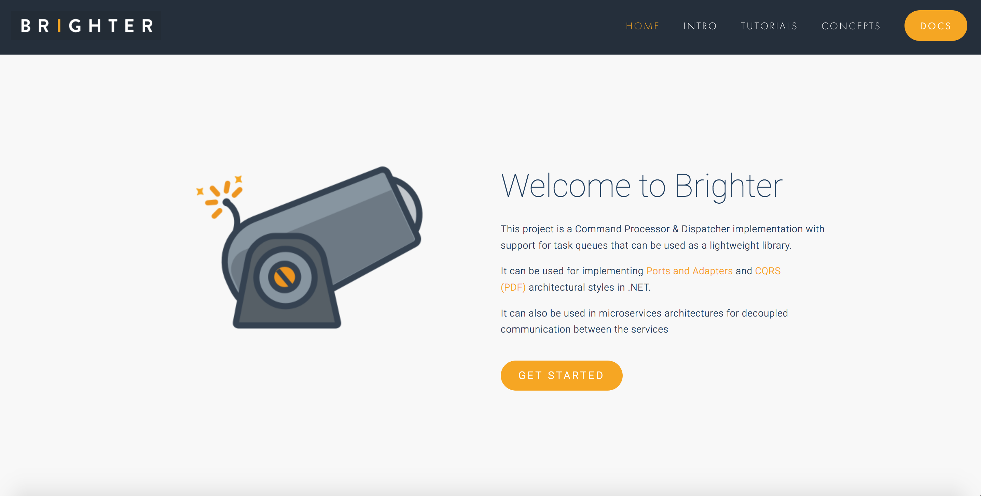

Slide 98


Slide 99


Slide 100
4.2 Python Framework

Slide 101
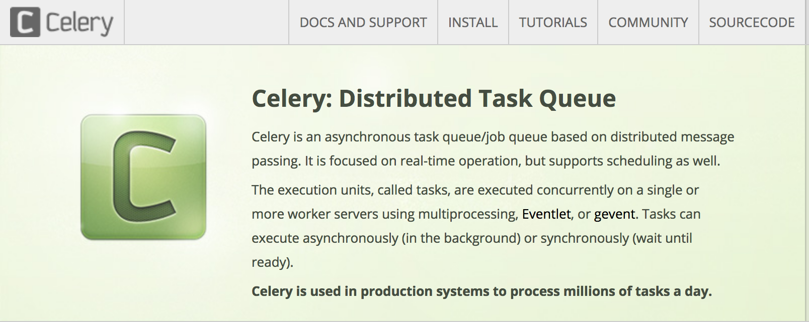

Slide 102
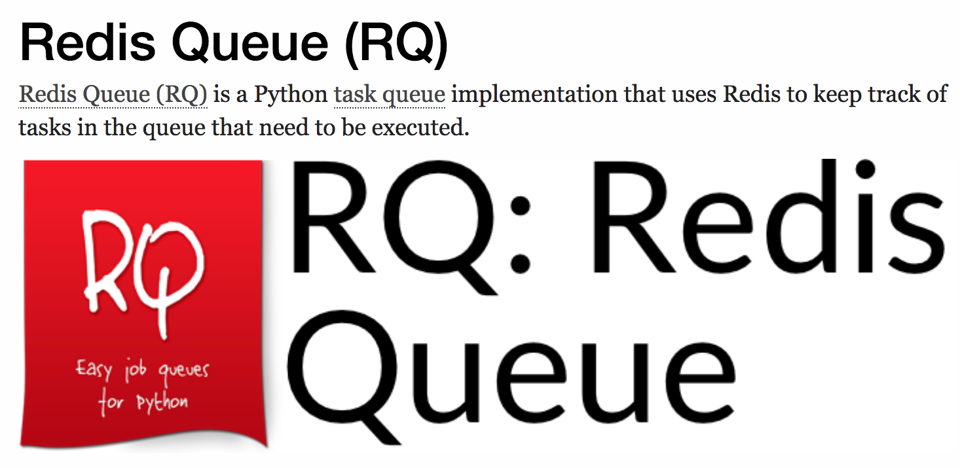

Slide 104
5. Message oriented middleware

Slide 105

Notes:
Written in Erlang and designed to support the amqp protocol.
RabbitMQ is a lightweight broker (its routing is very simple, so business logic does not creep onto the broker). It uses TCP/IP and can multiplex channels over a single connection. An exchange is a key concept being a dynamic recipient list where consumer register to receive messages.
Queues are FIFO
All limits are configurable
https://serverfault.com/questions/378165/rabbitmq-reasonable-performance-scale-expectations
The number of queues is limited by your RAM. The number of messages in play, on the other hand, is not limited by RAM because RabbitMQ automatically pages them out to disk. Once I accidentally got almost 8 million messages in play on a development server when I wasn't paying attention.
There is also no limit to message sizes, but you really should think twice if the size of a single message exceeds 512K. I ended up using a memory cache to pass large objects between applications and only sent smaller control messages that included a memcache key. But if you really want to you can send huge JPEG's and binary objects like JAR files as messages.
The number of subscribers is an OS limit because a subscriber needs at least one TCP socket open. Of course that is tunable in most OSes, so your mileage will vary and that is why you have to test your model. I have been using JMETER to load test our web applications and I just discovered this AMQP plugin https://github.com/jlavallee/JMeter-Rabbit-AMQP but have not yet used it. In any case, this is the kind of testing that will quickly tell you what your hardware (or VM config) will reasonably handle.
It continues to use amqp 0.9.1 as versions of the amqp protocol post 1.0 are wildly different. Although it is possible to implement something that looks like 0.9.1 under 1.0+ many of the core concepts in 1.0- such as exchanges are missing which means that the programming model is quite different. This is because amqp 1.0 is now just a messaging protocol and erases any notion of the broker. The result is that how you create queues etc. is implementation defined. This means that although there is a standard, clients have to be vendor specific because they always require interfacing with vendor protocols for creating exchanges queues etc.

Slide 106

Notes:
Redis is a distributed key-value store. It is in-memory, with optional durability. It is single-threaded, queueing requests to preserve ordering.
Redis maps keys to types of values. An important difference between Redis and other structured storage systems is that Redis supports not only strings, but also abstract data types:
Lists of strings
Sets of strings (collections of non-repeating unsorted elements)
Sorted sets of strings (collections of non-repeating elements ordered by a floating-point number called score)
Hash tables where keys and values are strings
HyperLogLogs used for approximated set cardinality size estimation.
Geospatial data through the implementation of the geohash technique since Redis 3.2.
It is used in queing both for its publish-subscribe feature and manually for those who don’t want a fan out model but a competing consumer model

Slide 107
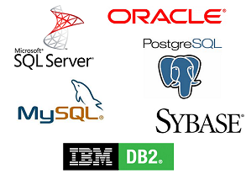

Slide 108


Slide 109


Slide 110


Slide 111
Next Steps

Slide 112
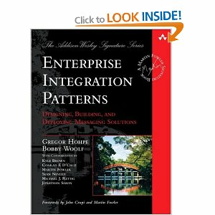
Further Reading

Slide 113
https://www.dropbox.com/s/ux9ra6g2v1l5n4l/Practical%20Messaging%20-%20Day%201.pptx?dl=0
https://www.dropbox.com/s/zks11le1xn05h39/Practical%20Messaging%20-%20Day%202.pptx?dl=0
https://www.dropbox.com/s/zks11le1xn05h39/Practical%20Messaging%20-%20Day%202.pptx?dl=0

Slide 114
Q&A

